Slide 1
Stress and Health
Psychology 3916

Slide 2
Introduction
Our behaviour has serious health effects
Smoking
Other drugs
Diet
Reaction to stress

Slide 3
Health Psychologists
How do our perceptions affect our reaction to stress
Emotions, personality and disease
When/why do some seek treatment (and of course why do some not)

Slide 4
Stress and Illness
Evolution and the fight or flight response
Made great sense 100 000 years ago
Maybe today you just got pwned playing Halo (or insert whatever FPS you play)

Slide 5
Good things about stress
Sometimes it will save your life, or help you
Fight
Accident
Test…

Slide 6
What is stress?
The process by which we appriase and cope with environmental threats and challenges
Good a definition as any
Careful, the idea of stress is way over used

Slide 7
How does it work?
Cannon
Fight of flight
Epinephrine, norepinephrine
Heart rate goes up
Breathing increases

Slide 8
Seyle
Injected rats with various hormones
Found enlargement of adrenal cortex
Shrinkage of thymus
Ulcers
Other liquids did the same thing!
Same response to fear, shock etc.

Slide 9
General Adaptation System
1) Alarm reaction
Heart rate up
Blood to skeletal muscles
2) Resistance
Stay ‘up’
Peak
Hormones released until you don’t have any more

Slide 10
More GAS
3) Exhaustion
Defenses depleted at this point
Very vulnerable
Lots of this is bad
Leads to destruction of hippocampal cells caused by cortisol release
So, memory loss!

Slide 11
Stressful Events
Catastrophes
Nobody likes these
Significant life changes
Death
Divorce
Job loss

Slide 12
Stressful Events
Daily Hassles
Loud neighbours
Annoying profs…
Bad weather
Coffee maker breaks down
Your team loses
While these seem like nothing, if you are facing other bad stuff they can add up

Slide 13
Perceived Control
Effects of stressors are mediated by perceived control
Optimists fare better in life than pessimists
Less control, more stress hormones released

Slide 14
Coronary Heart Disease, Stress and Personality
Friedman and Rosenman got the ball rolling
Fat in diet and smoking were equal in men and women
Men got CHD not women
Men had higher stress jobs
Accountants were fine until April

Slide 15
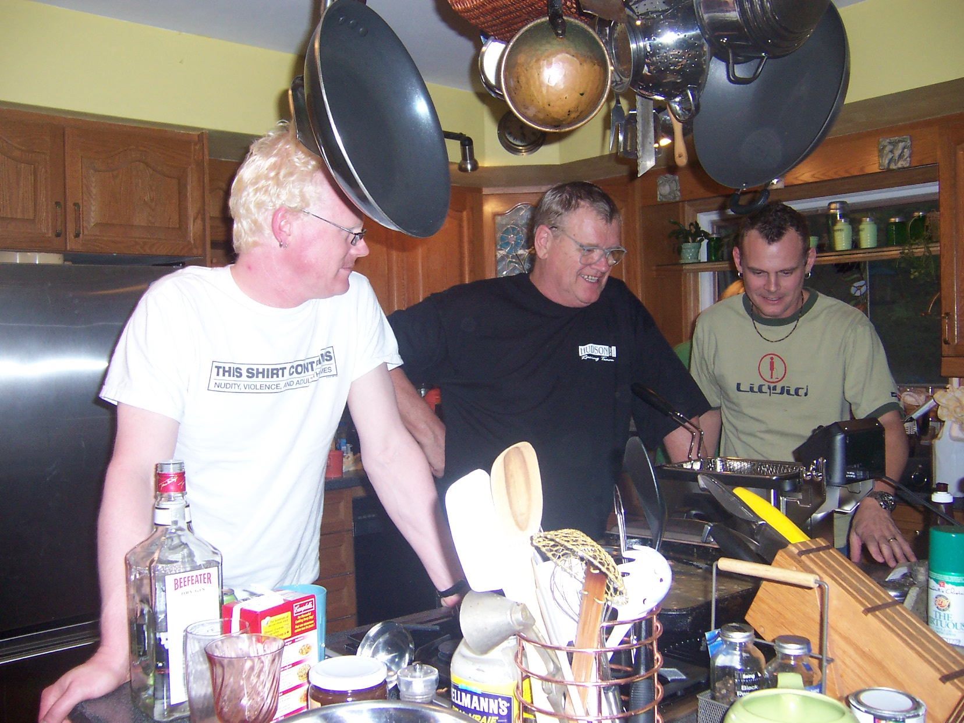
Type A Personality
Type A personality
Driven
Time dependent
Why more CHD?
Sleep less
Smoke more
Fly off the handle more easily
anger

Slide 16
Stress and the Immune System
Immune system has two types of cells
B Cells fight bacteria
T cells fight viruses, cancer
Stress suppresses the immune system
Diverting resources to the GAS
More infections
Even more cancer

Slide 17
Remember
Only a healthy lifestyle can help you in a big way
You can’t smoke, drink, smoke crack, have unprotected sex and say “Oh, but I have a positive outlook, so I will be just fine…
Health psychologists are also interested in promoting health, why people go to the Dr. etc.

Slide 18
In other words….
How do you deal with stress
Aerobic exercise is the key
Probably helps you stay in the resistance phase of the GAS for longer
Therefore, less exhaustion

Slide 19
Dieting
Hard to change your set point
Dieting alone is less effective than diet and exercise
You do not ‘burn off’ fat and turn it into muscle

Slide 20
The Paleolithic Prescription
Is is all vegetable?
Is it all meat?
No it is just less dense!
So not as processed
See we could not get fat and sugar in the quantities we can now

Slide 21
Acceptance
Advantages
Happier so less stress
Disadvantages
Still overweight…
Much of the publicity is poorly done

Slide 22
Conclusions
Stress is good
Stress is bad
Your mom was right

