Slide 1
Comparative Cognition
Psychology 3717

Slide 2
Introduction
Comparative psychology is almost as old as the discipline itself
People have wondered what animal is smarter than what other animal for years
Many studies have looked for things such as serial position effects, short term and long term memory etc in rats and pigeons
There is an implicit question here

Slide 3
And that question is….
‘Can rats do what humans do?’
On the surface this seems an interesting question and indeed almost sensible
What is the basis for such a question?
Well, we must be at the top of some sort of evolutionary ladder (Campbell and Hodos, 1969)
WRONG thanks for playing

Slide 4
There is no top, there is no goal
These ideas are, simply, wrong!
The much better question is ‘what has driven some species to be able to solve a certain type of problem?’
What selective pressures then, have lead to the evolution of certain cognitive mechanisms
Asking what species is the smartest is a silly question

Slide 5
So, how do we do comparisons
Let’s say we compare two species on some task
How do we know that any differences we find in cognitive ability may not be due to differences in motivation?
Bitterman’s ideas

Slide 6
MacPhail
MacPhail basically says that in science we start out with the null hypothesis, that nothing happened, there is no effect
In our case, there is no difference between two species
But keep that motivational thing in mind, any difference could be motivational

Slide 7
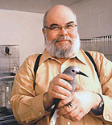
Al Kamil’s response
There is a bit of a flaw there
You set up an hypothesis that you cannot reject!
So how do we fix it Al?
Test many species on many paradigms

Slide 8
OK, I am with you so far Al
If we find similar differences in many different tests, it is unlikely that motivation will always be the culprit
Error cancels
Look at life history, biology, neuroscience and psychology
Ask what sort of differences should have evolved
Make PREDICTIONS

Slide 9
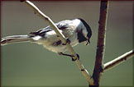
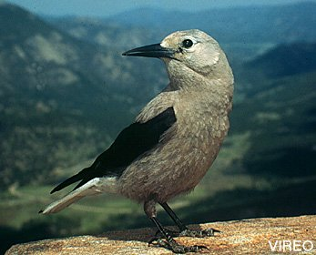
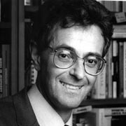
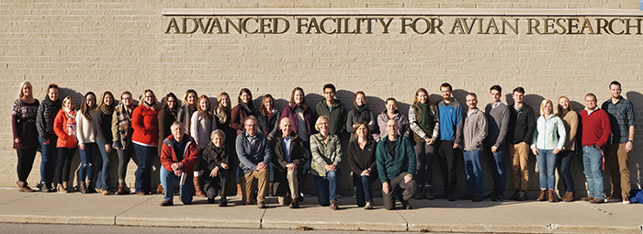
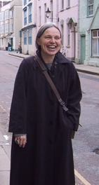
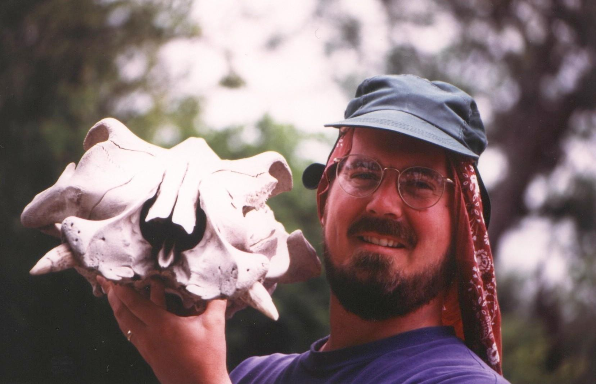

Slide 10
Most awesomest example ever of the synthetic approach
Anderson and Krebs, 1978
Mathematical model of when food storing should evolve
Food storing can only evolve if you recover your own caches
Sherry, Avery and Stevens (1981)
Birds seem to recover own seeds using memory

Slide 11
More data
Shettleworth and Krebs, 1982
Marsh tits storing seeds in a lab
Better at recovery of cached seeds than randomly placed seeds
Half of seeds removed
They are using memory
In other general memory tests, there have been clear differences between storers and non storers in the corvid family

Slide 12
We have already discussed the hippocampal differences
But what about the parids?
Data are equivocal
Maybe it is not how much they remember, but how they remember

Slide 13
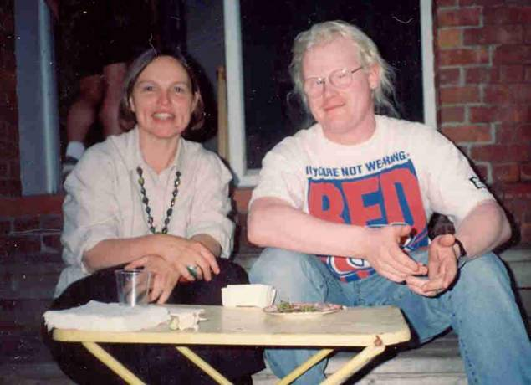
Qualitative vs. Quantitative differences
Brodbeck and his colleagues…. (ahem) pioneered this type of work
Comparing storers and non storers on what they remember in different tasks
Brodbeck, 1994; Brodbeck and Shettleworth, 1995

Slide 14
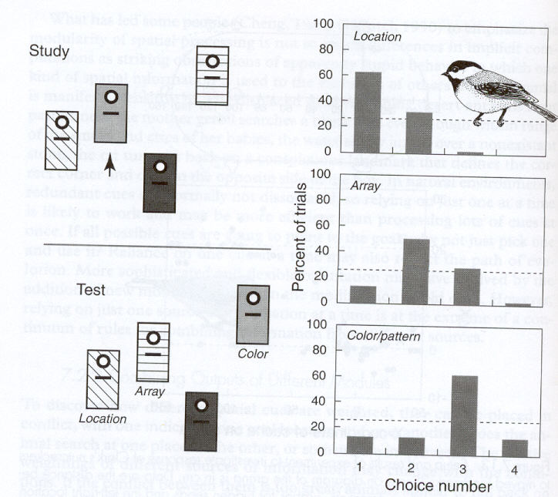
Brodbeck, 1994
Chickadees would find a seed in a feeder
Usually return later and eat it
Move them around to dissociate colour and spatial location
The chickadees responded last to the correctly coloured feeder
Non storing Dark Eyed Juncos responded to all three cue types equally

Slide 15
And the comparisons continue
Same thing on a smaller scale using a computer touch sensitive monitor
Birds rewarded for going to one place and not another
Different coloured patches
Switch them around
Chickadees rely on space, juncos do not
Indeed, in another experiment it was determined that chickadees when directly tested to very poorly on coulor!

Slide 16
Functionally
Well functionally this makes a lot of sense
Birds remember WHERE something is, not what colour it is
Colours change
That line of trees over there is still going to be over there
However, the strange result really is that of the junco!
Brodbeck, Boisvert, Vaughan and Grant (1997)

Slide 17
Memory for Space/Colour Compound Stimuli in Pine Siskins
David R. Brodbeck¹ and Jessica M. Humber²
1- Psychology Department
2- Environmental Science Unit
Sir Wilfred Grenfell College
Memorial University of Newfoundland

Slide 18
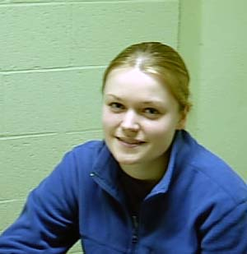
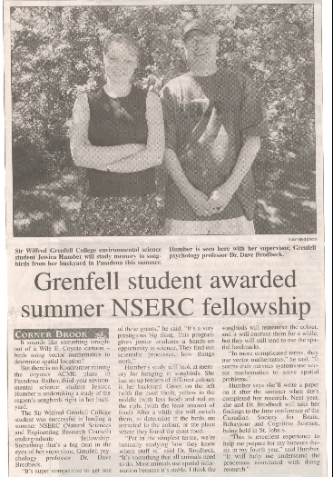
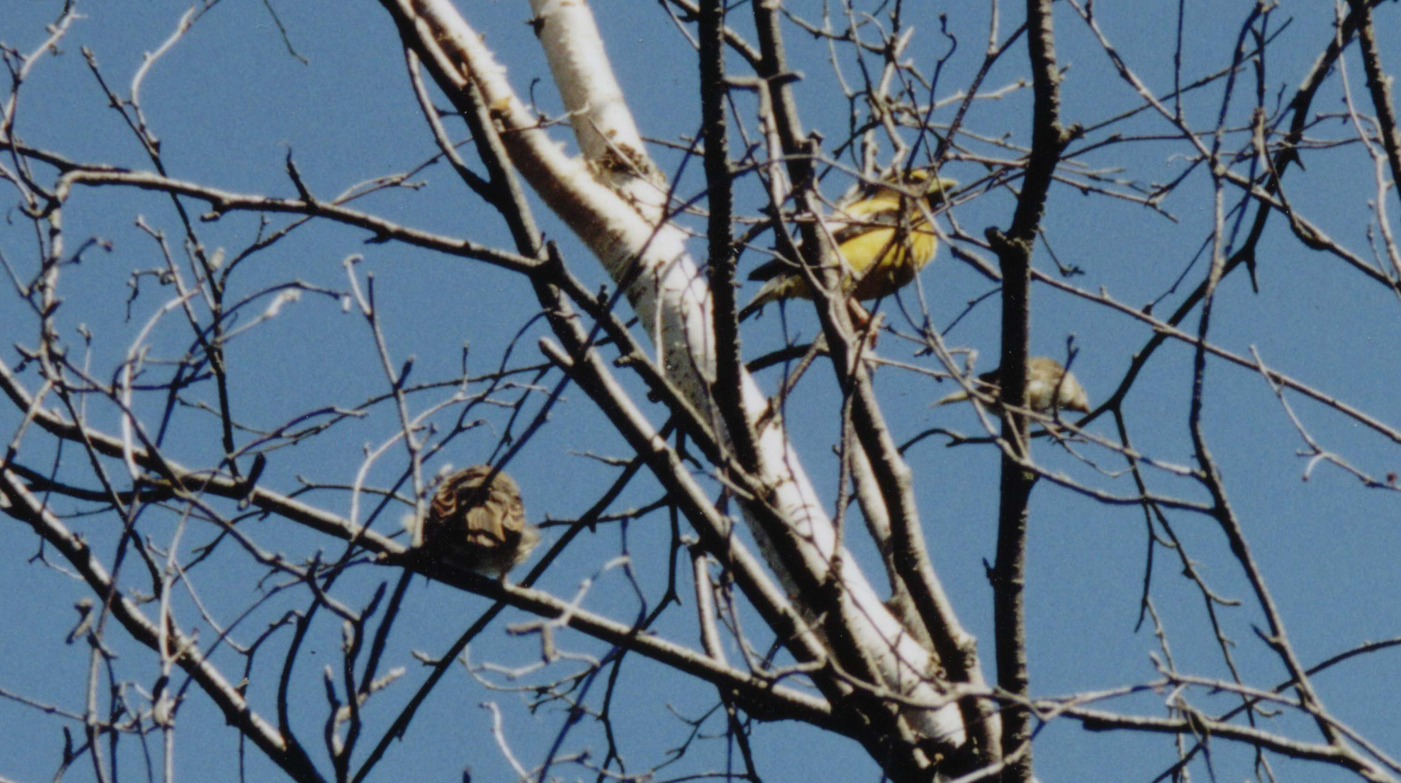

Slide 19
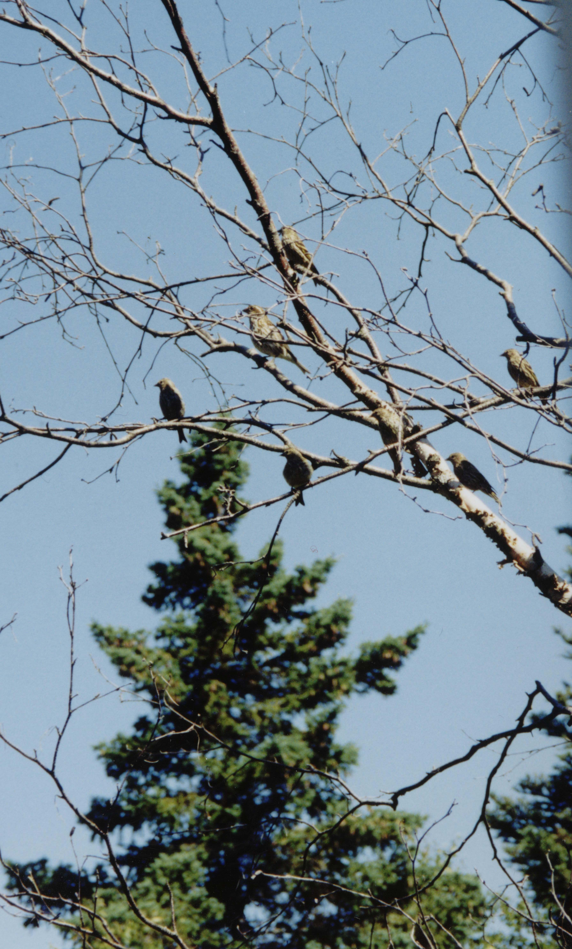
Introduction
Pine Siskins are finches that breed in Northern North America and conduct the odd invasion into Central and Southern parts of the US and even in to Mexico
Their abundance on the West Coast of Newfoundland made them an ideal subject for field study

Slide 20
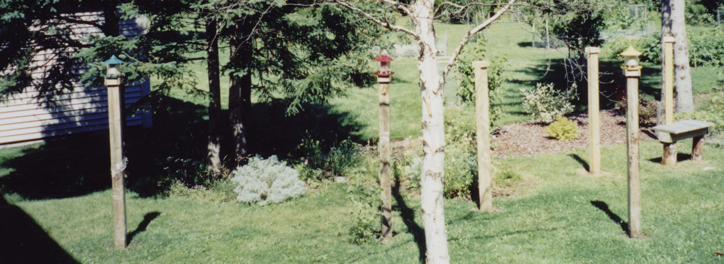
Introduction
We decided to test, first of all, if they could be trained to go to different feeders that had different amounts of food
Feeders were placed a few metres apart with sunflower seeds in a 3:2:1 ratio

Slide 22
Seems they can…
The birds distributed their feeder visits roughly in a 3:2:1 ratio
This of course could be due to the birds actually seeing how much seed was in each feeder
Or they could have emptied the rightmost feeder first, the centre one second and the leftmost feeder last…..

Slide 23
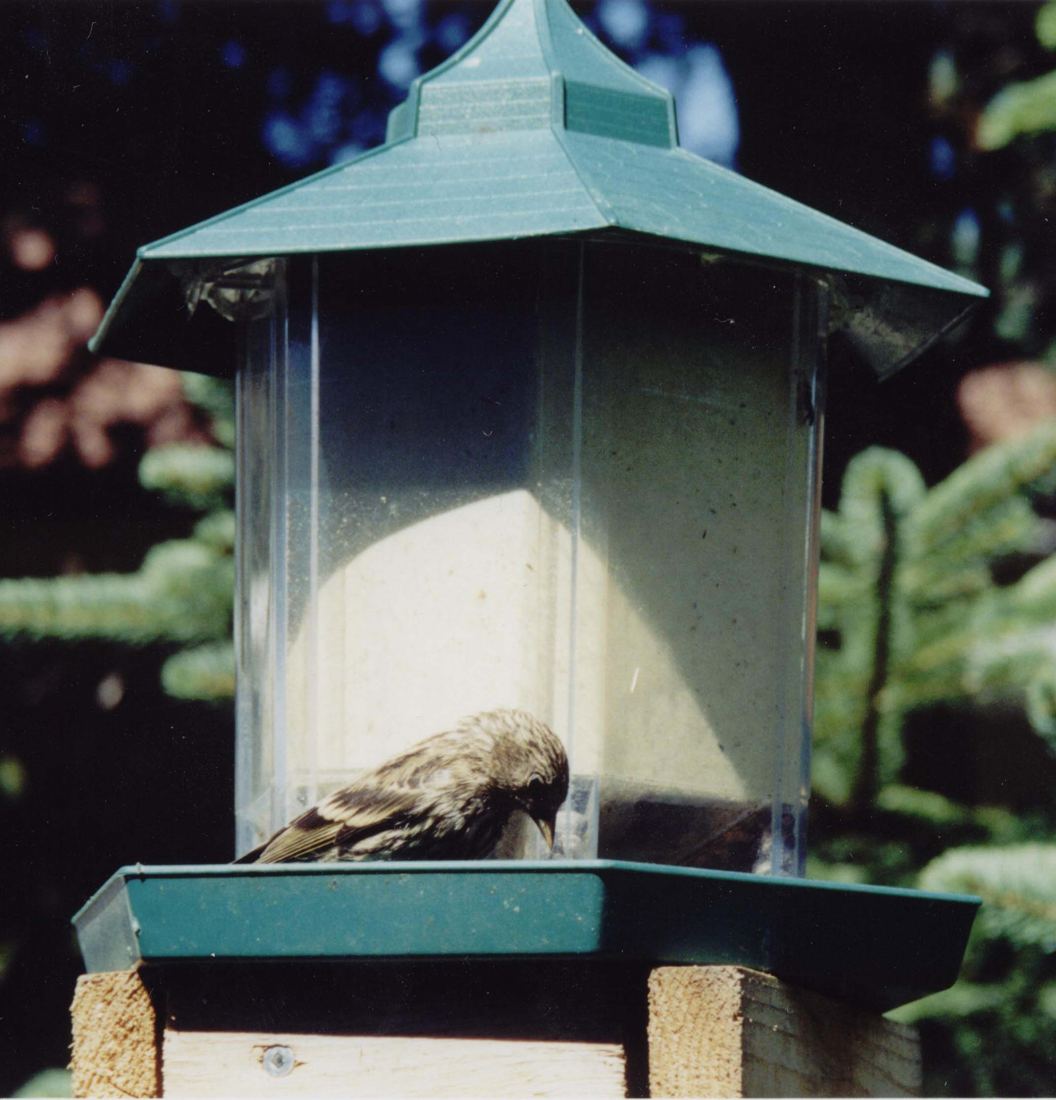
Well there’s an empirical question if I ever heard one…
Well we covered up the feeders and started swapping one feeder with another during test observation sessions
So, instead of say ‘green’ ‘red’ ‘yellow’ we would now have, on one test ‘red’ ‘green’ ‘yellow’

Slide 24
Unbaited Test Sessions

Slide 25
So what does it all mean
Good question…
Seems the siskins respond based on space, sort of
They respond based on space if the most profitable feeder is not in the exact opposite position it should be in
Once this happens they seem to treat the array as if it is a brand new array they know nothing about

Slide 26
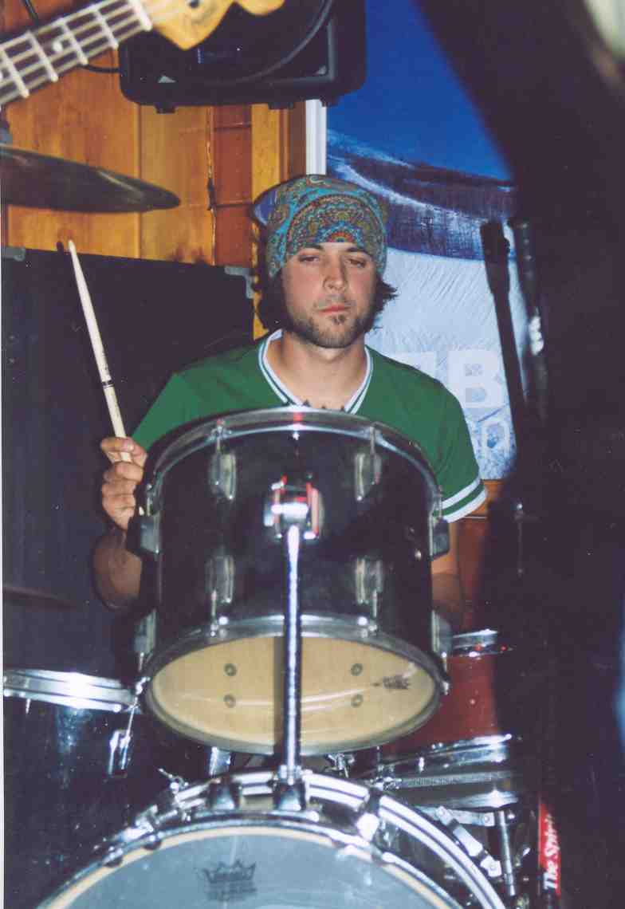
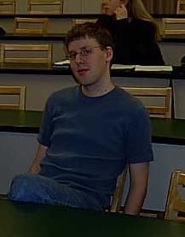
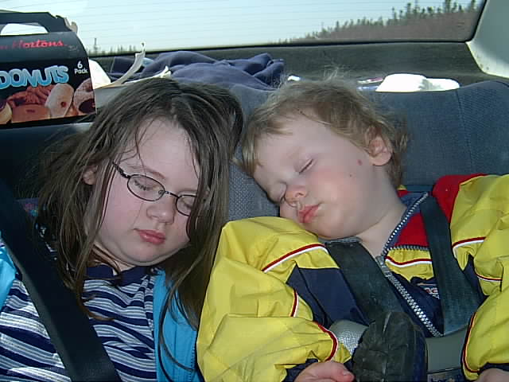
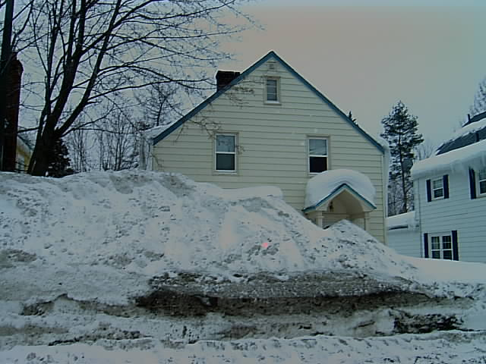
Thanks to

Slide 27
Animal Memory
Working Memory
Memory needed to solve one trial of a tast
Reference Memory
The rules of the game

Slide 28
Some cool preparations for studying animal cognition
Delayed matching to Sample
Delayed Non Matching to Sample
Can be qualitative differences here
(Mackintosh, Wilson and Boakes, 1982)
Both subject to proactive and retroactive interference
Symbolic matching and prospective and retrospective encoding

Slide 29
Roitblat 1980
Symbolic matching
1) Red sample -> Horizontal line
2) Orange Sample -> Vertical line
3) Blue Sample -> Almost vertical line
If they make mistakes when the choices are 1 and 2, they are encoding retrospectively
If they do when the choices are 2 and 3, they are encoding prospectively

Slide 31
More cool paradigms
8 Arm radial maze (Olton and Samuelson, 1976)
Macuda and Roberts (1997) found that rats actually chunk!
Directed forgetting experiments!
Inman and Shettleworth (1999)
Brodbeck (1997), Brodbeck and Caines (2008) pigeons show priming just like humans

