Slide 1
Gestalt Psychology
Psychology 4006

Slide 2
Introduction
Gestalt is a German word, and there is no real translation for it.
It is sort of ‘the whole is more than the sum of its pats’ kinda
It also sort of means ‘shape’
Oh and look, the Germans are back!

Slide 3
Origins
It is basically the first ’cognitive psychology’ we can talk about
Kant’s a priori perceptual and cognitive categories, plus the rationalism/empiricism balance
Christian von Ehrenfels used the term “Gestalt” when defining the whole as more than the sum of its parts.
“the radical view that the whole is psychologically, logically, epistemologically, and ontologically prior to its parts. A whole is not only more than the sum of its parts, it is entirely different from a sum of its parts.”
Carl Stumpf
Mentor to the gestalists

Slide 4
Early On
Max Wertheimer (1880-1943)
Apparent motion study (phi phenomenon) (1912)
With Kurt Köhler and Wolfgang Koffka at Frankfurt
Eliminated eye movements as an explanation and argued against unconscious inference
1916-1929 at Berlin Psychological Institute
With Köhler and Lewin
Concern over growing Nazi menace in 1930s
Moved to NY – New School for Social Research
Reproductive versus Productive thinking.

Slide 5
Kurt Kofka
One of the founders of Gestalt Psychology
The movement’s major theoretician
Extended gestalt ideas to developmental psychology
Considered “ideational” learning, that based on language acquistion, the ultimate form of learning
Introduced gestalt to U.S.
Article on gestalt psychology and perception (1922)

Slide 6
Wolfgang Köhler
Wolfgang Köhler (1887-1967)
Mentality of Apes study
Director of Berlin Psychological Institute, 1922-1935
“golden age” until Nazis came to power
1935 – left for U.S. (Swarthmore)
APA president – 1959
Sultan and the two-stick problem
Banana too far away to be reached by a single stick
Solution combine two sticks
Insight
Reorganizing the elements of the problem situation
Requires being able to view the entire field

Slide 7
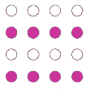
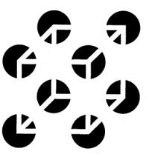
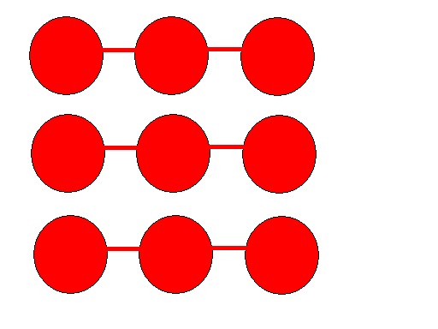
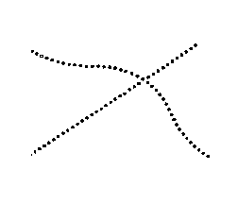
Gestalt Principles
Proximity
Closure
Continuity
Similarity
connectedness

Slide 8
The Gestaltists and Perception
Behavioral vs. geographical environment
Lake of Constance story
Behavioral : seemed like a snow-covered plain
Geographical: was actually a snow-covered frozen lake
Psychophysical isomorphism
Parallel organization for mind & body
Map metaphor

Slide 9
Other Gestaltists
Solomon Asch
Conformity studies
Stanley Milgram
Obedience to authority
Musafar Sheriff
Autokinetic effect
Robber’s Cave study

Slide 10
Conclusions
These people resisted the behaviourist tide
They kept thinking about thinking alive
They helped usher in the cognitive revolution

